Slide 1
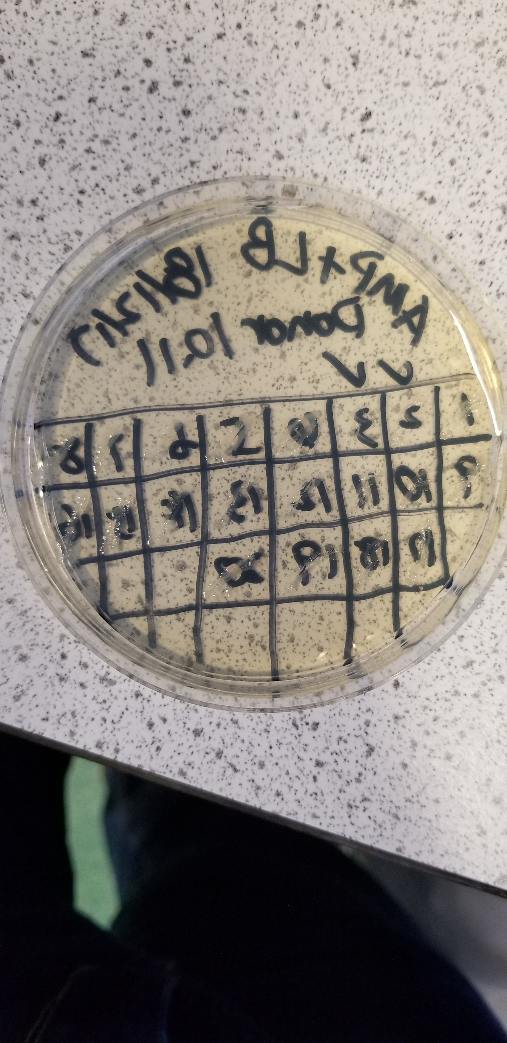
I am Haotian Tang
C
Population health science: MR
Synthetic biology: diffusion effects on biopathways
Biochemistry: CRISPR/Cas9
G
X
Y

Slide 2
Research Motivations
GWAS and MR
Reveal comorbidity process of hypertension and chronic kidney diseases

Slide 3
Next Big Challenge
The causal role of PAR1 on nephrotic syndrome [Th17 immune cells or something in plasma → regulation of cytokines]
Shared etiology of hypertension and CKD

Slide 4
Artistic summary of my research
Circulating clues weave,
Mendelian whispers unfold,
Nephron's secrets found.
OpenAI. (2021). ChatGPT [Computer software]. Retrieved from https://openai.com

